Slide 1

Multilinear Regression Model
Problem Statement: Construct Predictive Model
Collect, Formulate, Experiment, Evaluate, Recalculate

Slide 2
Challenges and Constraints
Data Collection
Knowledge of Regression
Power Of the line!
y = b + mx
Limit model to key set of data
Use Matlab regression systems
(And get Prof. Dundar’s help)
(Confidence intervals very large)

Slide 3
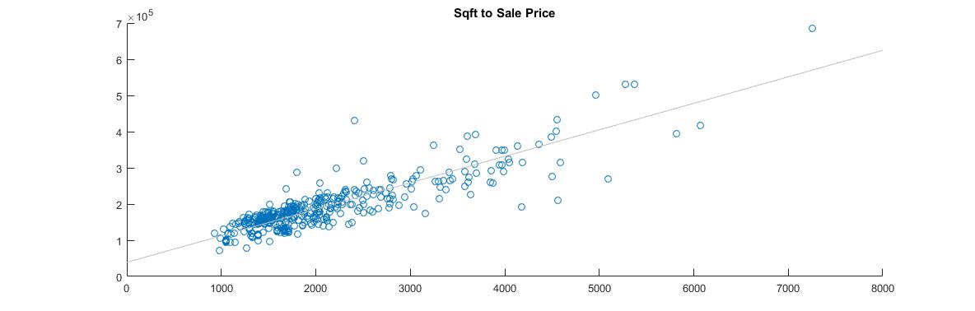
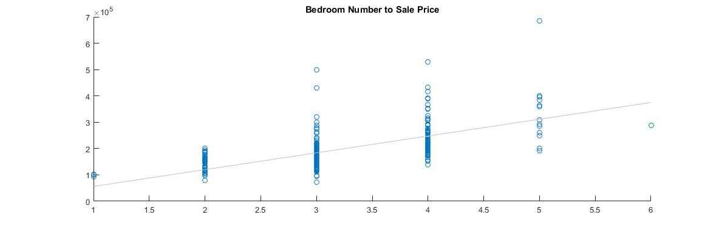
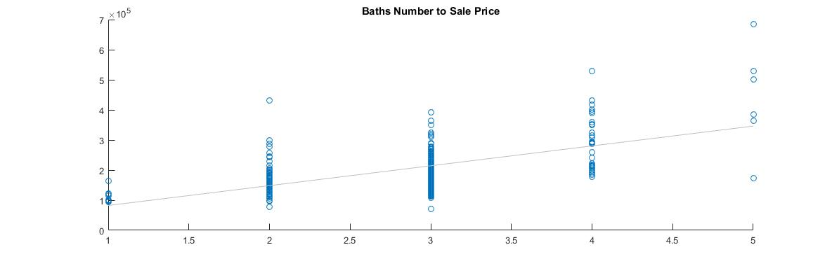
Data 1:

Slide 4
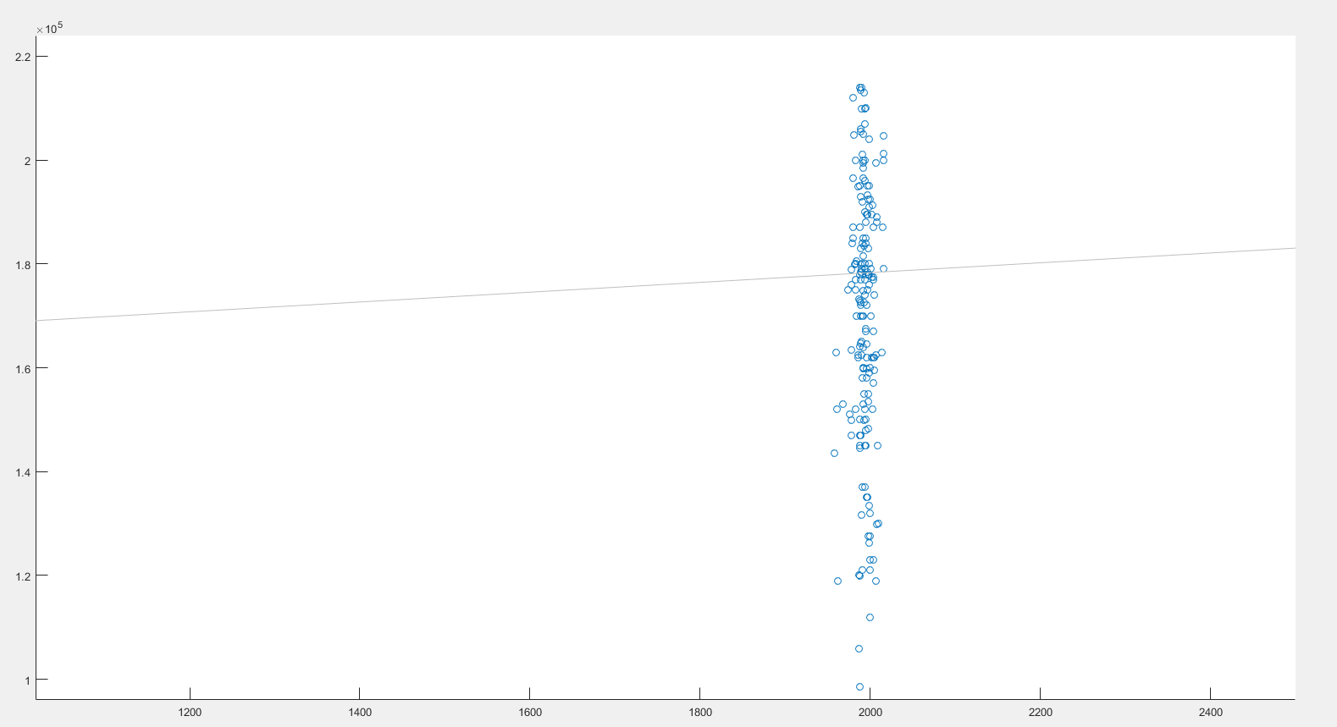
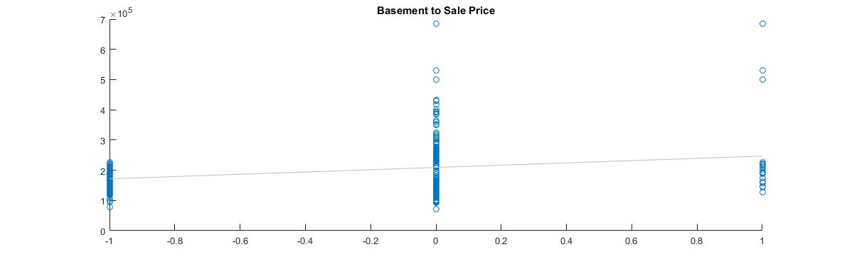
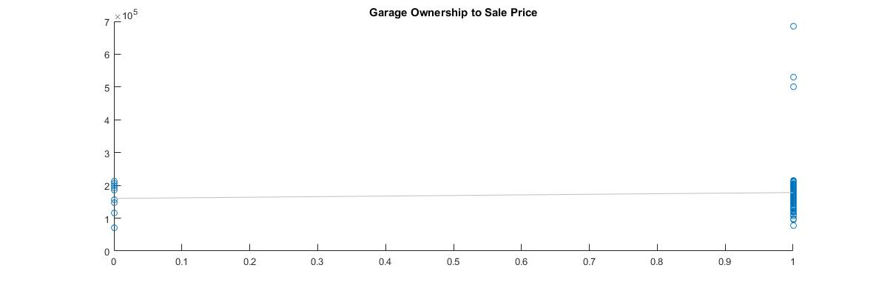
Data 2:

Slide 5
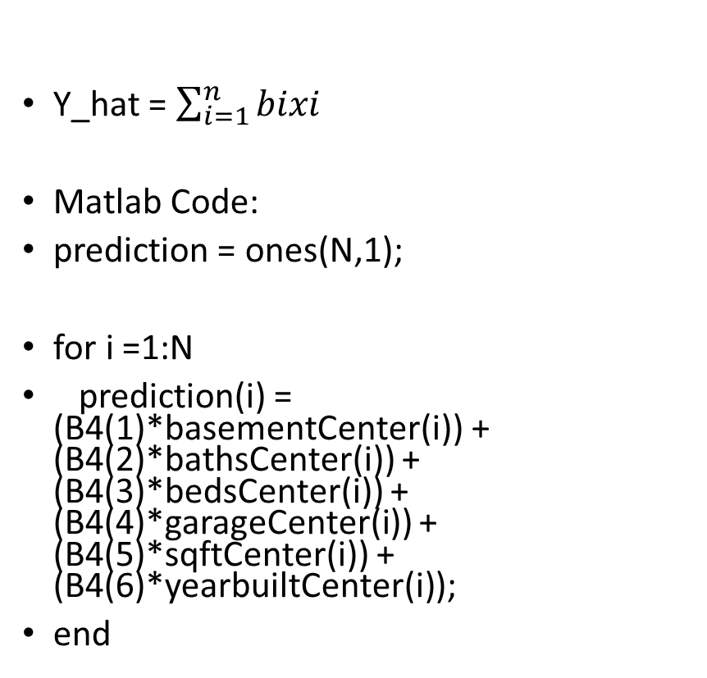
Method
Centralize Dataset:
x_newi = x_oldi – mean(X_old)
y_newi = y_oldi – mean(Y_old)
Compute the slope values via Matlab’s regression functions
B = Regress(Y,X)
Mathematically,
B = inverse(transpose(X) * X) * transpose(X) * Y_new
Utilize B and test Data in Prediction
Y_hat = $\sum_{i=1}^{n}{bixi}$
Matlab Code:
prediction = ones(N,1);
for i =1:N
prediction(i) = (B4(1)*basementCenter(i)) + (B4(2)*bathsCenter(i)) + (B4(3)*bedsCenter(i)) + (B4(4)*garageCenter(i)) + (B4(5)*sqftCenter(i)) + (B4(6)*yearbuiltCenter(i));
end

Slide 6
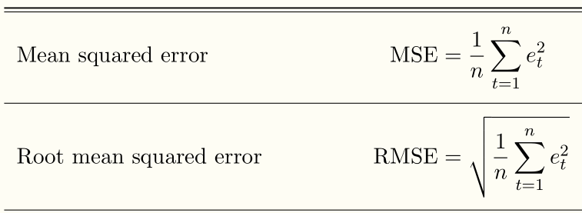
Evaluation
Matlab Code:
error = ones(N, 1);
for i = 1:N
error(i) =
(salepriceCenter(i) - prediction(i));
error(i) = error(i).^2;
end
MSE = mean(error);
RMSE = sqrt(MSE);
MSE ~= 3.3975e+7
RMSE ~= 1.8274e+05
Error ranged wildly.
Either dead on, or off by ~50,000
Certain parts of Dataset suspect

Slide 7
Conclusion and Improvements
Greatest Challenges:
Data Collection
Statistical Understanding
Model Evaluation and Refinement
Future Goals
Easy to construct a model
Hard to construct a good one
Correct prediction of past prices one thing…but what of future prices?

